Slide 1

AI vs ML vs DL Easily Explained

Slide 2
Definitions explained…
AI : “Technique which enables machines to mimic human behavior”
ex - Self Driving cars
ML: “technique which uses statistical methods to enable machines to improve with
experience”
Inaccurate Predictions : Programmer need to fix it
DL: “technique which uses neural networks to enable machines to
improve with experience with different capabilities”
Inaccurate Predictions : Model does it by himself
Confusions: All are subset/ superset of each other, so mix and merge problem
AI
ML
DL
Parsing data
Learning from Data (Training)
Predictions

Slide 3
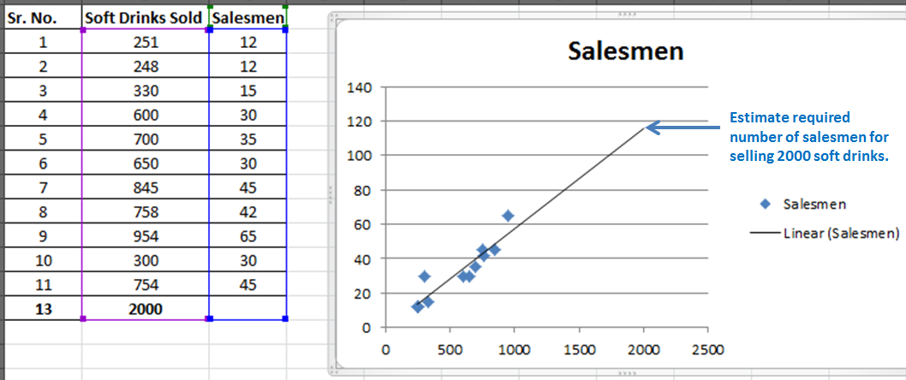
Machine Learning:
It uses algorithms based on mathematics and statistical methods to enable machines to improve with experience.
If a machine learning model returns an inaccurate prediction then the programmer needs to fix that problem explicitly.
Data : sales data, student data
ML Algorithms : Regressions, Classification, Clustering
Informed decisions: sales forecast for next quarter,
Student performance prediction
Data
Algorithms
ML
Predictions/Decisions

Slide 4
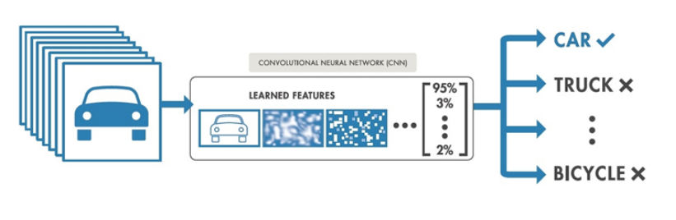
Deep Learning:
It technically functions in the same way as Machine Learning but it has different capabilities.
Its uses algorithms based on Artificial Neural networks and it works in same way as brain nervous system works.
Data: Images, Sensor Data
DL Algorithms: CNN, RNN, LSTM
Decision : Vehicle classification
Data
DL Algorithms
Predictions/Decisions

Slide 5
Factor | Machine Learning | Deep Learning
Data | Less Data | Large Data
Accuracy | Lesser | High
Time | Take lesser time to train model | Take more time to train model
Hardware | CPU | GPU
Example: Flashlight
Flashlight -- ML Model -- flashlight ON
Flashlight -- DL Model -- flashlight ON

